Slide 1
IOT BASED HOME AUTOMATION
USING AURDUINO
Under the guidance of:
S. Lalitha
Assistant Professor(CSE)
Presented by:
V.SAIBABA (16B81A05J4)
K.RUSHIDHAR RAO (16B81A05J1)
B.SANDESH REDDY (16B81A05M9)

Slide 2
Problem Statement
This project presents a low cost flexible and reliable home automation system with additional security using Arduino microcontroller, with IP connectivity through local Wi-Fi for accessing and controlling devices by authorized user remotely using Smart phone application. The proposed system is server independent and uses Internet of things to control human desired appliances starting from industrial machine to consumer goods. The user can also use different devices for controlling by the help of web-browser, smart phone or IR remote module.
To demonstrate the effectiveness and feasibility of this system, in this paper we present a home automation system using Arduino UNO microcontroller and ESP8266-01 as a connectivity module. It helps the user to control various appliances such as light, fan, TV and can take decision based on the feedback of sensors remotely. We have tested our system through conducted experiment on various environmental conditions.

Slide 3
Proposed System
The system has two parts, namely; hardware and software. The hardware system consists of Arduino uno board, Arduino wi-fi shield, sensors and home appliances. The software system consists of a java based android application also Arduino language is used to configure the Arduino uno board and the sensors. In this system, the components used are Arduino uno board, Arduino wi-fi shield, sensors(lm35 , LDR). These hardware components are used in order to control the home appliances. Arduino uno board will help to develop an interface between the hardware and the software application. This system also consists of a software application which is developed using android. The Arduino wi-fi shield will help in transmitting and receiving the input given by the user.

Slide 4
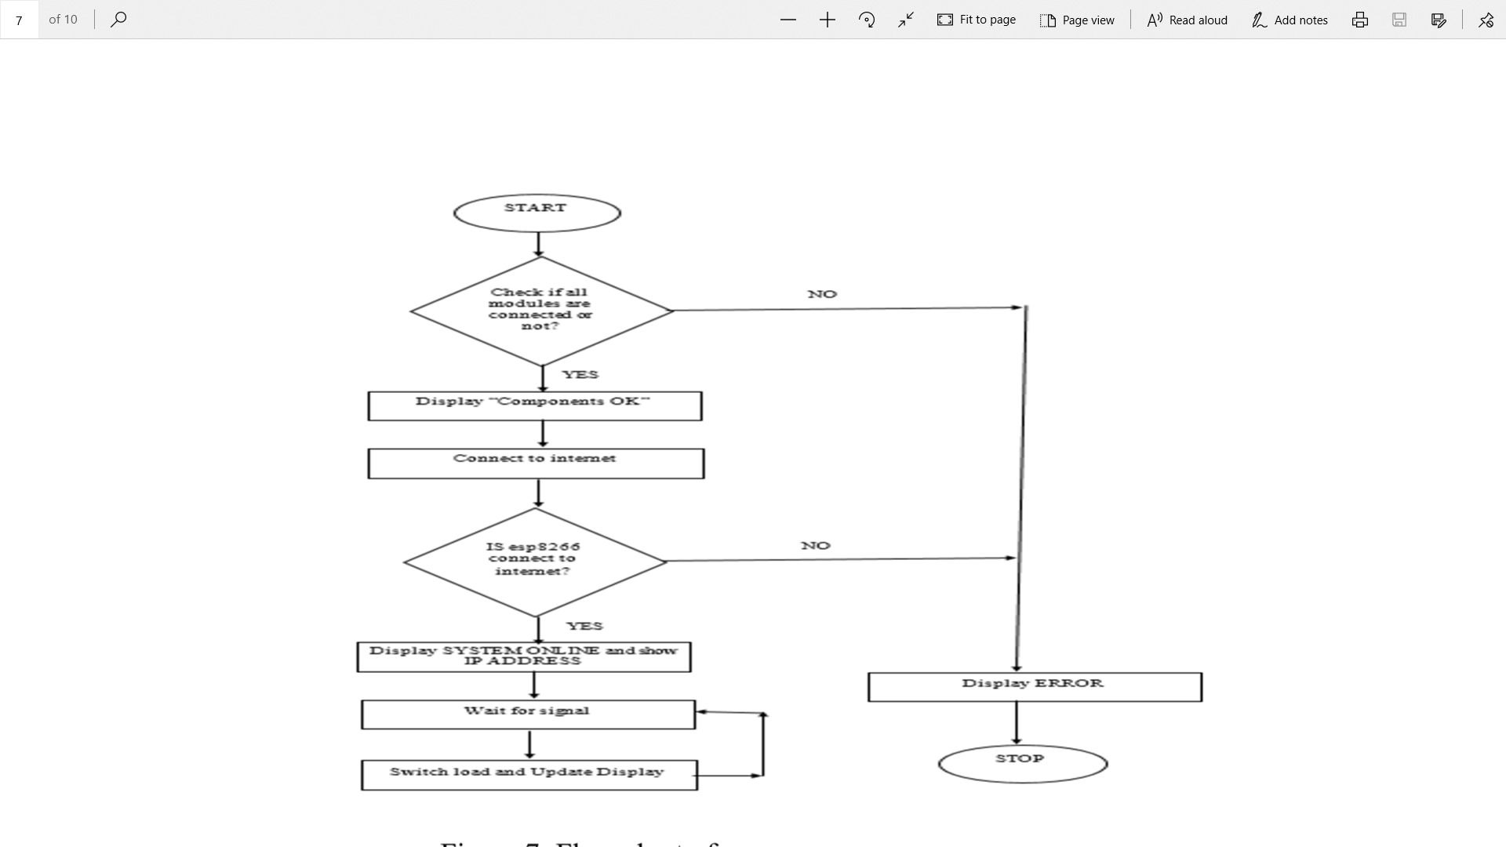
Flow Chart

Slide 5
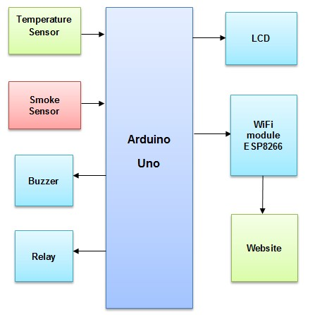
Architecture

Slide 6
Important Features
Fire sensors in automation have a wide range of applications. IOT based home automation alarm system using Arduino can be used in Chemical Factories, Shopping Malls, local shops, Educational institutes, Parking Areas, Companies etc.
IoT Based home automation alarm Notification System Using Wi-Fi can be used as a pre-cautionary measure at all the places listed above, which can help in notifying the fire departments early. If appropriate and immediate action is taken as soon as the buzzer turns ON, it can help in avoiding an accident.
Future Development of the IOT Based Fire Detection System is This project can be enhanced to sense leakage of LPG GAS.

Slide 7
Important Features
Fire Safety Alarm: This system includes fire alarm and fire protection. We used smoke detector and temperature sensor (LM35) to detect fire and an alarm is used with this. On the other hand a solenoid valve connected directly with water supply is used to extinguish the fire.
Anti-Theft Alarm: We used touch sensor around the house as anti-theft system. We also used an alarm. When anyone touches the sensor it switched the alarm ON.
Components used:
ESP8266 WiFi Module
Arduino Micro controller
Relay Circuit

Slide 8
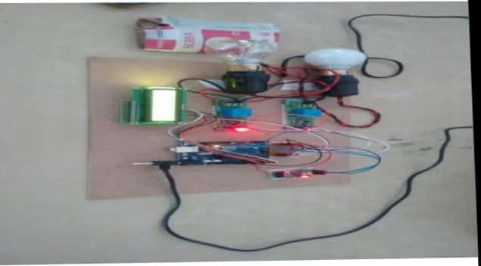
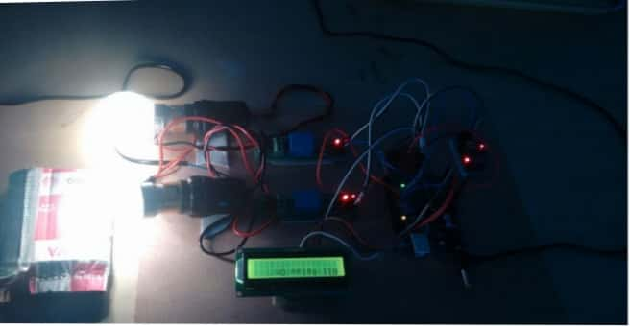
Output Screens
Fig A: Connecting components to Arduino
Fig B: Bulb glowing using Iot technology

Slide 9
Conclusion
Home automation systems allow detailed control over lighting, heating, cooling, security and cctv systems and more. The advanced wireless solutions can transform any ordinary home into a smart home and with dedicated software to support different applications there are endless possibilities to select from. This system is more flexible and provides attractive user interface compared to other home automation systems.

Slide 10
THANK YOU

